Slide 1

E-Commerce Purchase & Management System
[1]
Data Structures & Algorithms Lab
19ECSP201
3rd Sem, Division C
Febraury, 2021
1. Courtesy => google.com

Slide 2
TEAM
SL No. | NAME | USN
1 | Akshay R Shanbhag | 01FE19BCS164
2 | K Siri Chandana | 01FE19BCS173
3 | Mohammad Ayan Khan | 01FE19BCS168

Slide 3
PROBLEM STATEMENT
To design a E-Commerce Purchase & Management System for Indian artisans who produce different Indian handcrafted goods and articles. To connect them to the digital world, sellers from pre-listed locations list their goods. Potential customers can view the goods & purchase by authenticating themselves on this platform and prioritizing their speed of delivery & location. Discounts & taxes are added at this stage and Mode of Payment is “Cash on Delivery” only. There is a provision for the customers to know their history of purchases.
Sellers dequeue the priority queue of orders received & deliver the goods to customers based on their priorities.
This can really benefit all those incredible artisans to connect to a larger market and increase their presence and profitability.

Slide 4
INPUT DATA FILES
seller.txt (totally 30 sellers)
customer.txt (totally 500 customers)
items.txt
locations.txt (totally 50 locations)
adjacency_matrix.txt (it is a 50*50 matrix)

Slide 5
OUTPUT DATA FILES
history.txt (has information of all purchases made)
shortest_distance.txt (stores the shortest distance between any seller to customer location in the form of matrix)

Slide 6
SYNOPSIS OF THE SYSTEM
Out of 500 customers, any 10 random customers purchase the goods from any 10 random sellers out of 30 sellers
The Purchased goods are added to the cart and the customers checks out.
The customers are billed taking total of his cart, applying discounts and adding taxes.
The order is hashed into the purchase_table for maintaining history of purchases and also written to history.txt file
Customers choose their delviery speed
Priority is calcualted based upon the delivery speed chosen and shortest distance between seller and customer
Accordingly, items are enqueued into priority queue of each seller
Finally, the sellers deliver the items by dequeuing their respective priority queues
This cycle repeats

Slide 7
STRUCTURES USED
Seller_Information : Information of sellers[their name, location, and array of items, seller_ID]
Articles: Information on items [ item name, item_ID, item_popularity, cost, item_discount ]
Customer_Information : Information of customer[ their name, location, customer_ID, username, password, purchase_history_hashes]
Cart : Shopping bag of the customer [seller_ID, item_ID and cost of items being purchased by the customers]
Temporary_Stack : For maintenance of cart
Authentication : Stores the username and password being entered by the customer for log-in
Delivery_Queue : Each seller has his own delivery queue where the item_ID and customer_ID are stored
Purchase_Table : History of purchase orders linked with the purchase_hash_code, customer_ID, payment_amount of the purchases, made by the customer.
Purchase Items : For storing information of items purchased linked to purchase table
Delivery_speed : contains speed [Normal/ Fast/ One-Day], purchase_hash opted by the
customer.
Locations: Structure used for creating adjacency matrix for use in Floyd Warshall Algorithm
to find shortest path between buyer and seller. Contains, seller_location, buyer_location.

Slide 8
FUNCTIONS USED
0. void seller_read() => Reads seller information from seller.txt file
1. void populate_location() => Reads location from location.txt file
2. void customer_read() => Reads customer information from customer.txt file
3. void floydWarshall() => Runs Floyd Warshall Algorithm
4. void authentication_load() => Reads authentication information to structure
5. void get_shortest_distances() => reads adjancency matrix from adjacency_matrix.txt file and initiated floyd Warshall
6. void heapify() => Heapifys the priority queue to Max Heap
7. void deleteRoot() => Dequeue function for delivery of orders
8. void print_Array() => Printing after delviery
9. void fill() => Initializes the priority queue of every seller to NULL
10. void insert() => inserts elements into priority queue
11. void push() => pushes purchased items into cart stack
12. void pop() => Pops after check out by the customer for billing
13. void fill_stack() => fills the stack for calculation of priority
14. void purchase() => This function purchases the items
15. void login() => Authenticates whether it is a valid Login
16. void forward() => Forwards the user to start shopping from Main function
17. void printSolution() => Prints the shortest distance matrix to shortest_distance.txt file
18. void display() => Displays the loaded seller structure (called only if necessary)

Slide 9
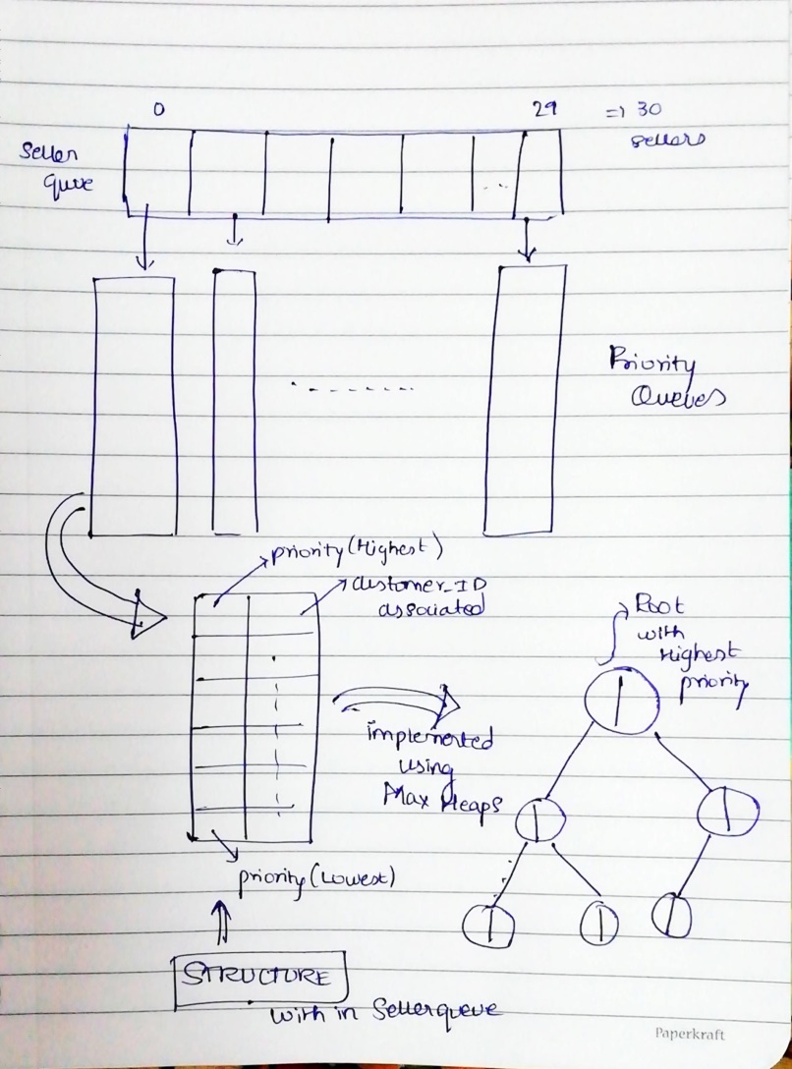
DELIVERY QUEUE STRUCTURE

Slide 10
PRIORITY CALCULATION
FORMULA=>
DELIVERY SPEED [3/2/1] *1000 + index(arr[d])
Where,
d = distance between seller and customer location
arr is a stack that is sorted using insertion sort

Slide 11
DATA STRUCTUES USED
Stacks
Priority Queues
Files
Graphs (for implementing Floyd Warshall Algorithm)
Hash Tables (for storing Purchase History
which can be found in history.txt file)
Binary Tree (for Implementing Max Heap)

Slide 12
ALGORITHMS USED
Insertion Sort
Floyd Warshall Algorithm
Heapify for implementation of priority queues.

Slide 13
FINAL NOTES
TOTAL NUMBER OF LINES IN CODE => 1482
TOTAL NUMBER OF ERRORS => 0
TOTAL NUMBER OF WARNINGS => 0
=> Language : C
=> IDE used : Code-Blocks
The team used github for regularizing and easy maintenance of code
Link for the repository
https://github.com/akshayrshanbhag/DSA_Ecommerce
We were efficient in managing our work and adhering to the deadlines
This project provided all team members great practice and opportunities to learn new concepts and share them among ourselves
Overall, as a team, we are satisfied and learnt a lot from this project.

Slide 14
THANK YOU

